Slide 1


PARASITIC EGG MULTICLASS OBJECT DETECTION AND COUNTING IN MICROSCOPIC IMAGES
Alan Turing X Al Jazari
4 Nov 2023

Slide 2
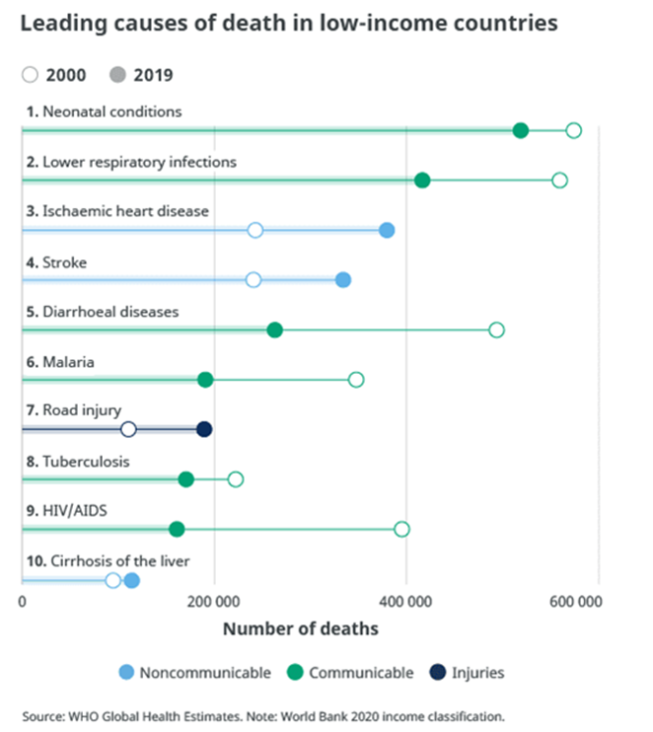
Background & Problem Statement
Parasitic infections have been recognized as one of the most significant causes of illnesses by WHO. Diarrheal disease, which is often caused by parasitic infection is the TOP 5 leading cause of children death in low-income countries.
Diagnosis of intestinal parasites is usually based on direct microscopic examination, which require trained/skilled personnel that often lacking in remote region.
THAT IS WHY we need a new tool for diagnosis that is easier to perform even by any person without medical/laboratory capacity, and have a very good sensitivity and specificity.

Slide 3
Objective
To develop robust algorithm to detect eggs of parasitic worms in a variety of microscopic images that is easier to perform even by any person without medical/laboratory capacity, and have a very good sensitivity and specificity.

Slide 4
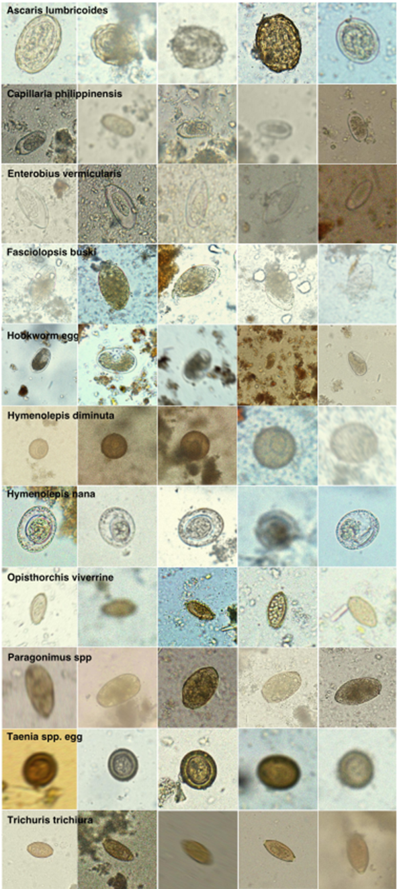
Data Collection & Preparation
Dataset taken from :
Parasitic Egg Detection and Classification in Microscopic Images(ieee-dataport.org)
Dataset contain 11 parasitic egg types, each has 1,000 images :
category 0: Ascaris lumbricoides
category 1: Capillaria philippinensis
category 2: Enterobius vermicularis
category 3: Fasciolopsis buski
category 4: Hookworm egg
category 5: Hymenolepis diminuta
category 6: Hymenolepis nana
category 7: Opisthorchis viverrine
category 8: Paragonimus spp
category 9: Taenia spp. egg
category 10: Trichuris trichiura
Annotation Format : COCO JSON

Slide 5
Data Preprocessing
Dataset comes with default preprocessed images :
Apply Gaussian blur with a standard deviation between 0.0 - 3.0
Crop each side by a random value from 0 to 30%
Apply motion blur (10% of total images) with a random kernel size of 3- 35 pixels and orientation of 0-360 degree
Apply Gaussian noise with a standard deviation between 0.0 - 25.5 (to each colour channel separately)
Apply Poisson noise with a lambda (the expected rate of occurrences) between 0.0 - 5.0
Adjust image saturation by adding a value in a range of -25 - +25 to the S channel of the HSV colour space
Adjust contrast using gamma correction with a gamma value between 0.5 - 2.0

Slide 6
Experiment 1
Model : YOLO-NASm
Dataset used : 20 % of full dataset
Split into train(160/cat), valid(40/cat), test
Batch : 16
Epochs : 30
Workers : 8
Optimizer : AdamW

Slide 7
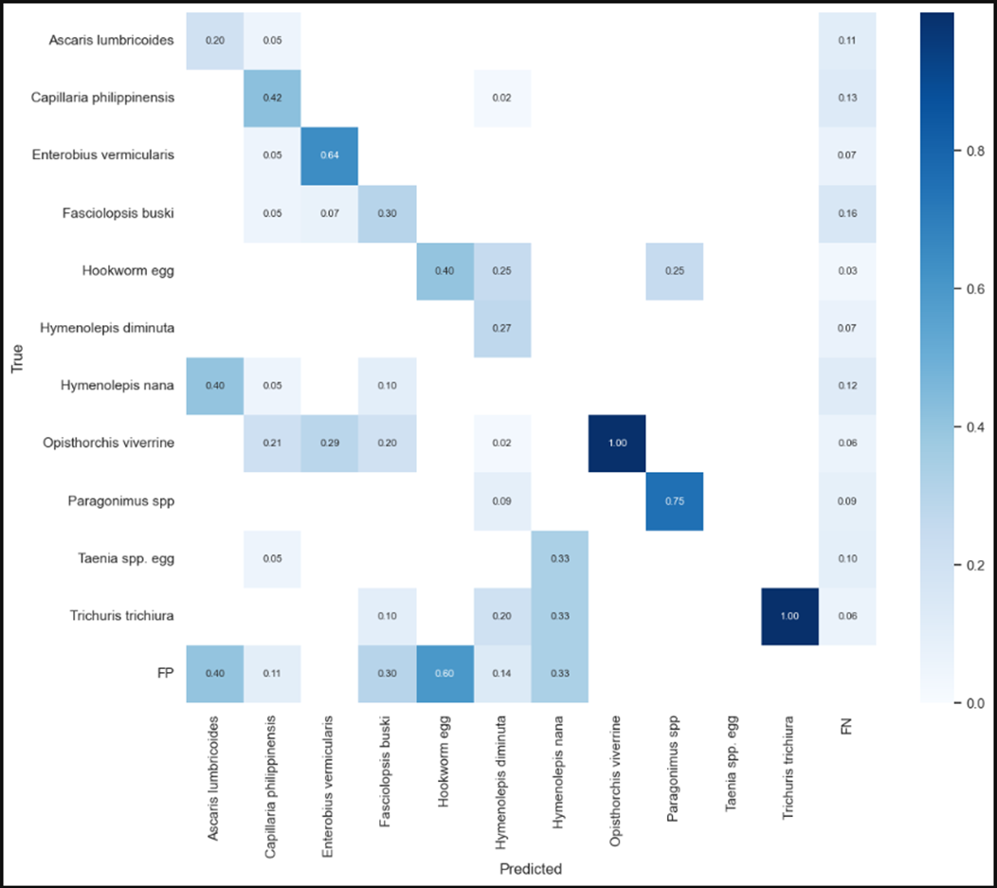
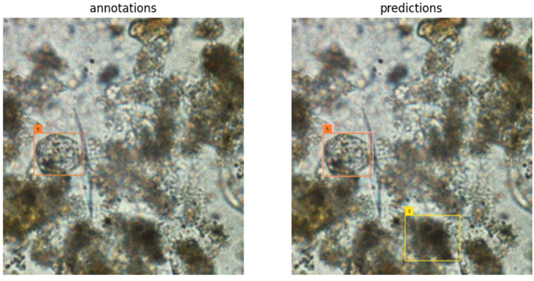
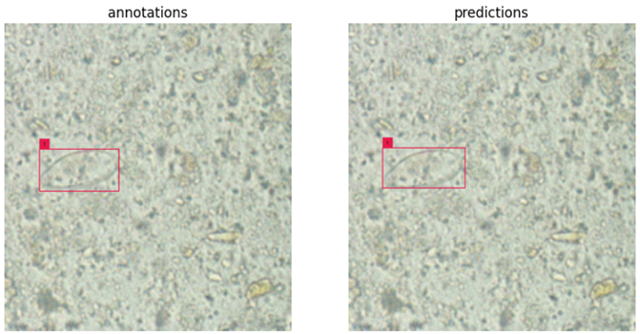
Experiment 1 Result
Precision : 0.694
Recall : 0.531
mAP50 : 0.592
F1 score : 0.549

Slide 8
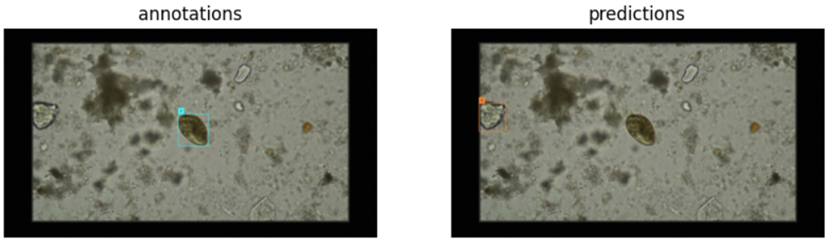
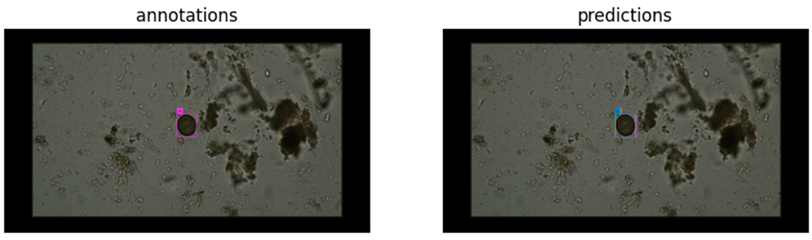
Example of False Positive and False Negative Prediction
Example of Double Detection prediction

Slide 9
Experiment 2
Model : YOLOv5m
Dataset used : Full dataset
Split : Train 8800 (800 per category) Val 2200 (200 per category) Test 2200
Batch : 12
Epochs : 40
Workers : 32
Optimizer : SGD

Slide 10
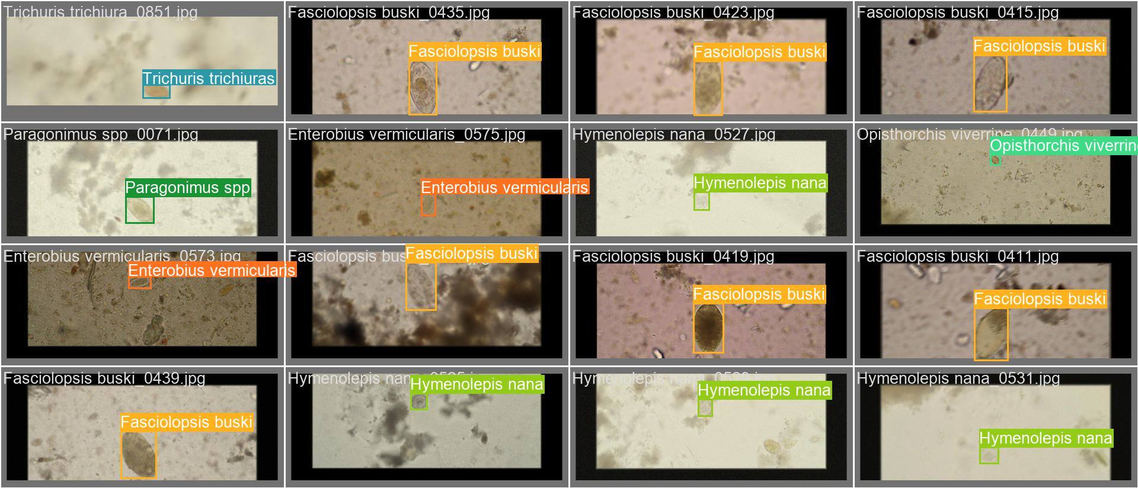
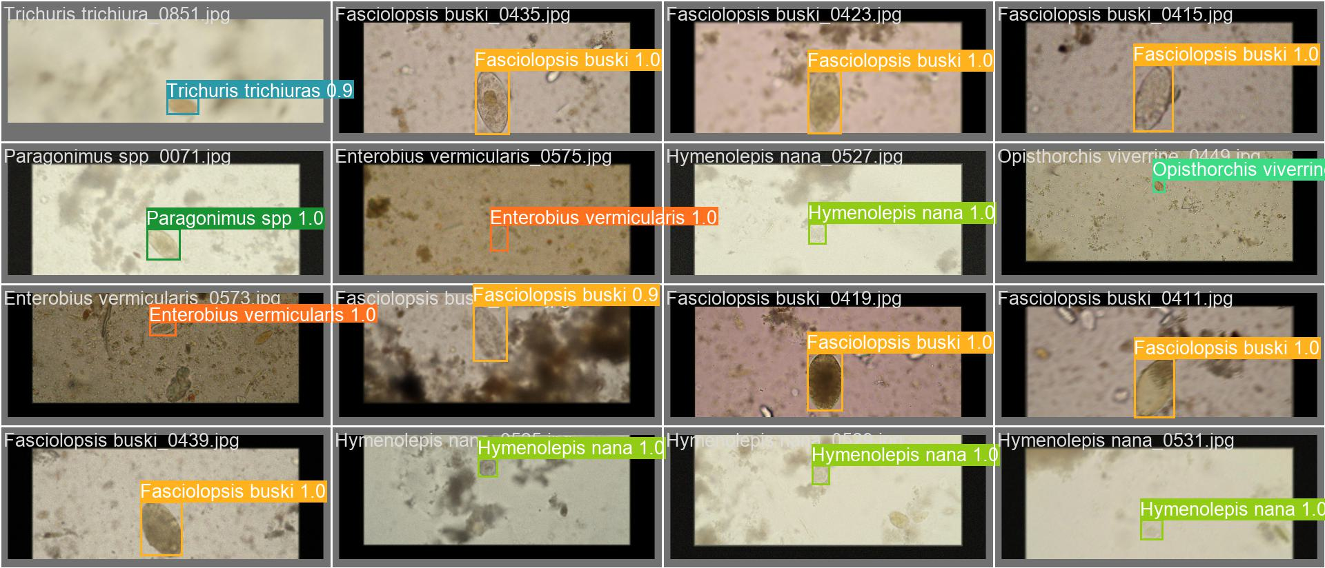
Results
metrics/precision :0.994
train/cls_loss : 0.0015849
train/box_loss : 0.010212
train/obj_loss : 0.0040075
metrics/mAP_0.5 : 0.99371 val/box_loss : 0.0076392
val/obj_loss : 0.0024887
val/cls_loss : 0.0000907
Error Test : 5.5%
Annotation
Validation

Slide 11
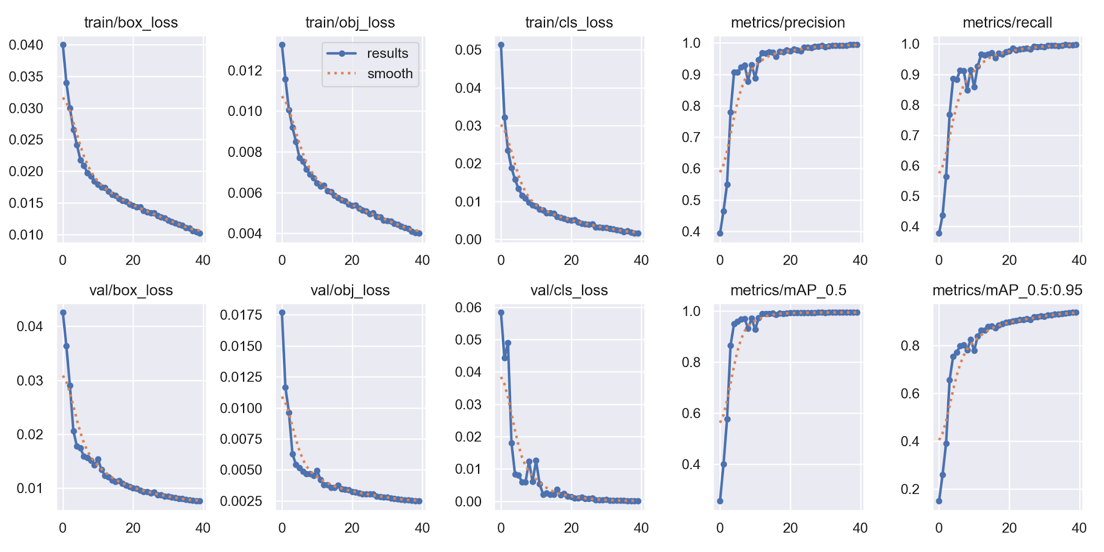

Slide 12
Experiment 3
Model : YOLOv5m
Dataset used : Full dataset
Split : Train 8800 (800 per category) Val 2200 (200 per category) Test 2200
Batch : 12
Epochs : 40
Workers : 32
Optimizer : AdamW

Slide 13
Results
train/box_loss : 0.0087767
train/obj_loss : 0.0032953 train/cls_loss : 0.0007418 metrics/precision : 0.99633
metrics/mAP_0.5 : 0.99423 val/box_loss : 0.0065768
val/obj_loss : 0.0021143
val/cls_loss : 0.0000749
Error Test : 8.5%
Annotation
Validation

Slide 14
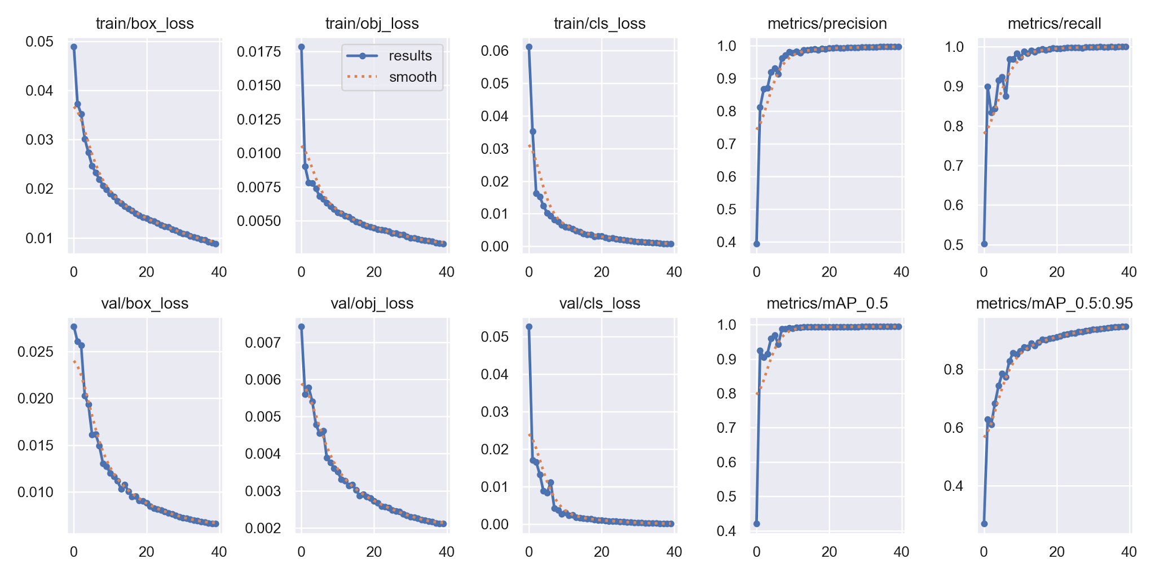

Slide 15
Experiment 4
Model : YOLOv5l
Dataset used : Full dataset
Split : Train 8800 (800 per category) Val 2200 (200 per category) Test 2200
Batch : 12
Epochs : 40
Workers : 32
Optimizer : SGD

Slide 16
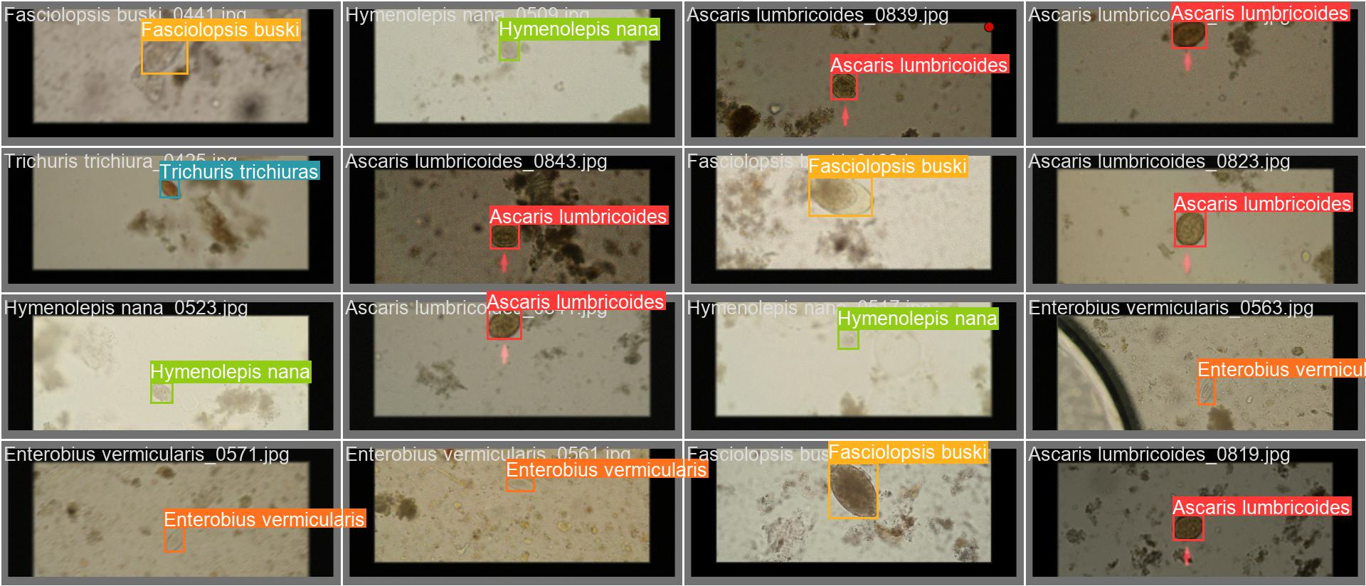
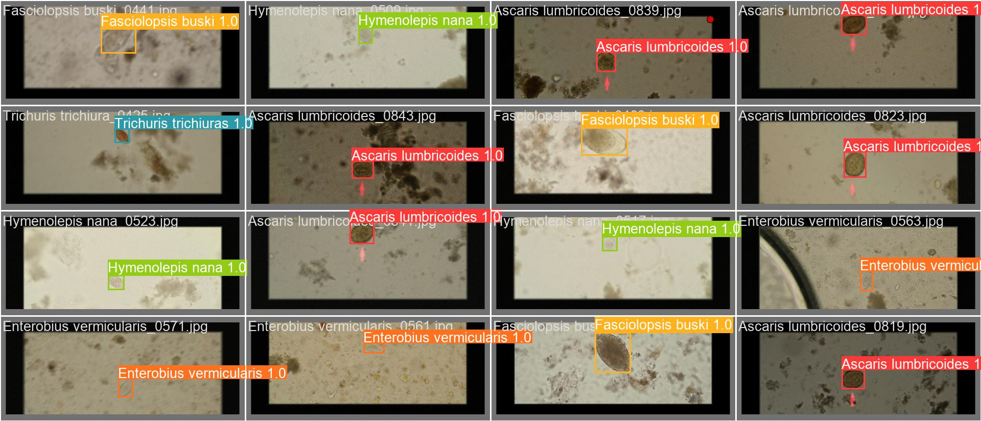
Results
train/box_loss : 0.008242
train/obj_loss : 0.0030932 train/cls_loss : 0.00070246 metrics/precision : 0.99695
metrics/mAP_0.5 : 0.99444 val/box_loss : 0.0061847
val/obj_loss : 0.0019867
val/cls_loss : 0.000069369
Error Test : 7%
Annotation
Validation

Slide 17
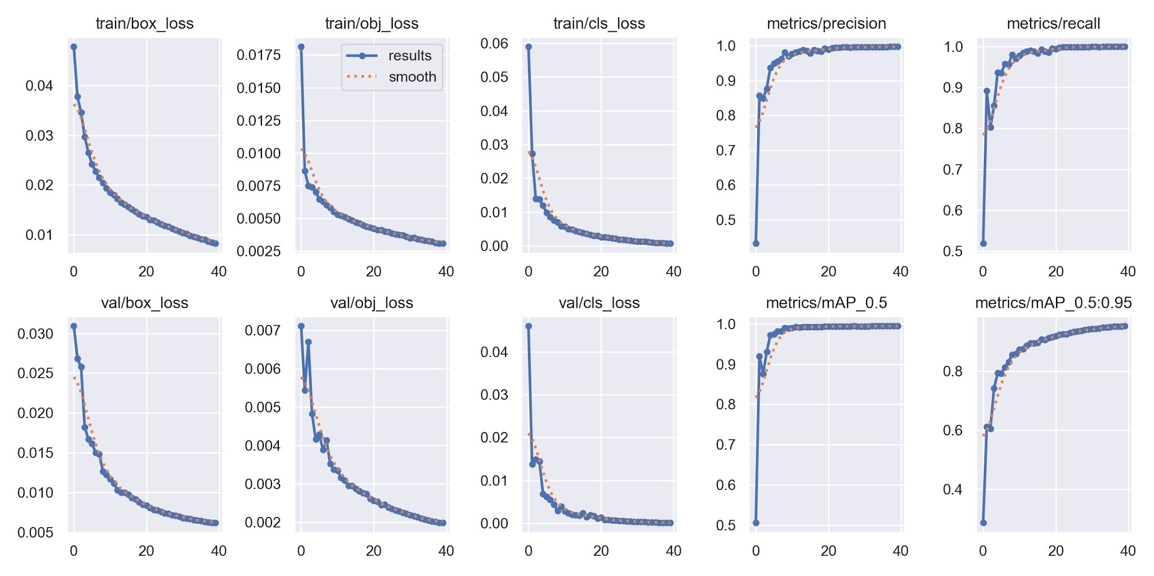

Slide 18
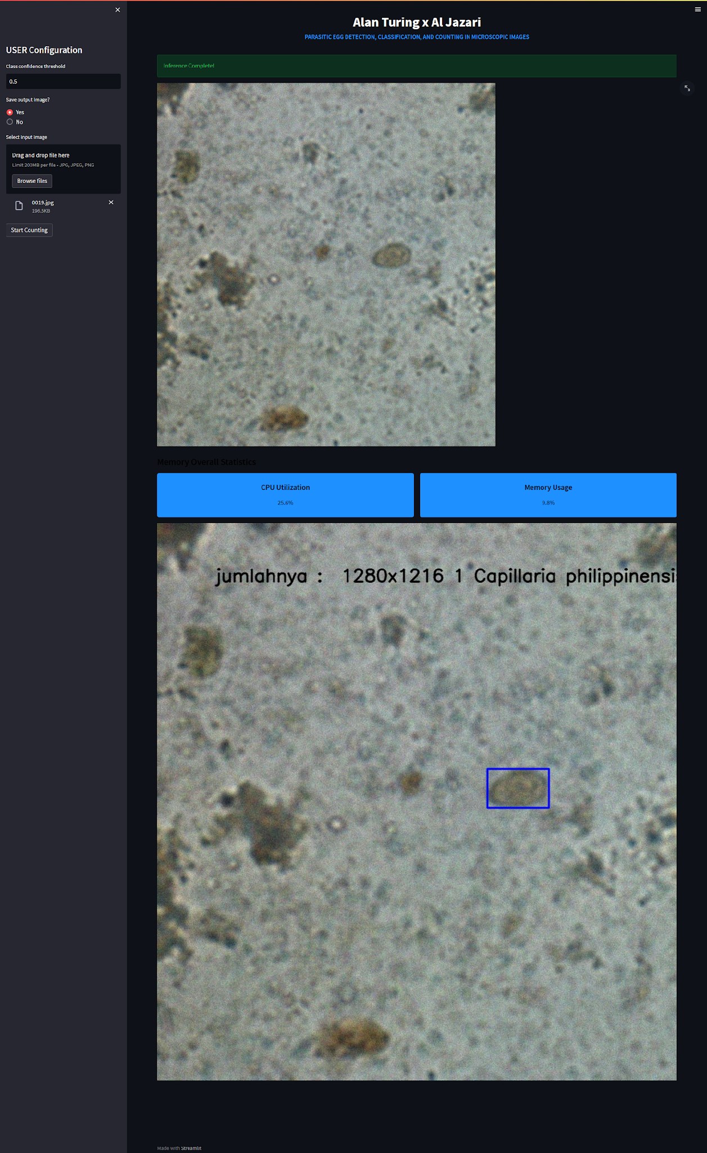
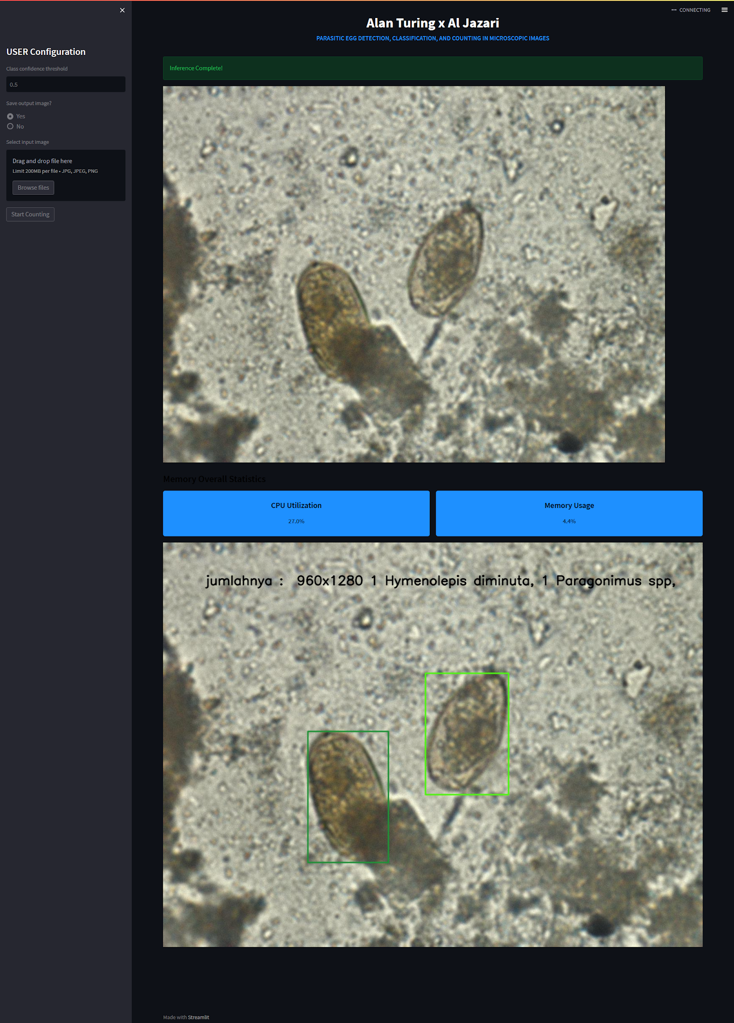
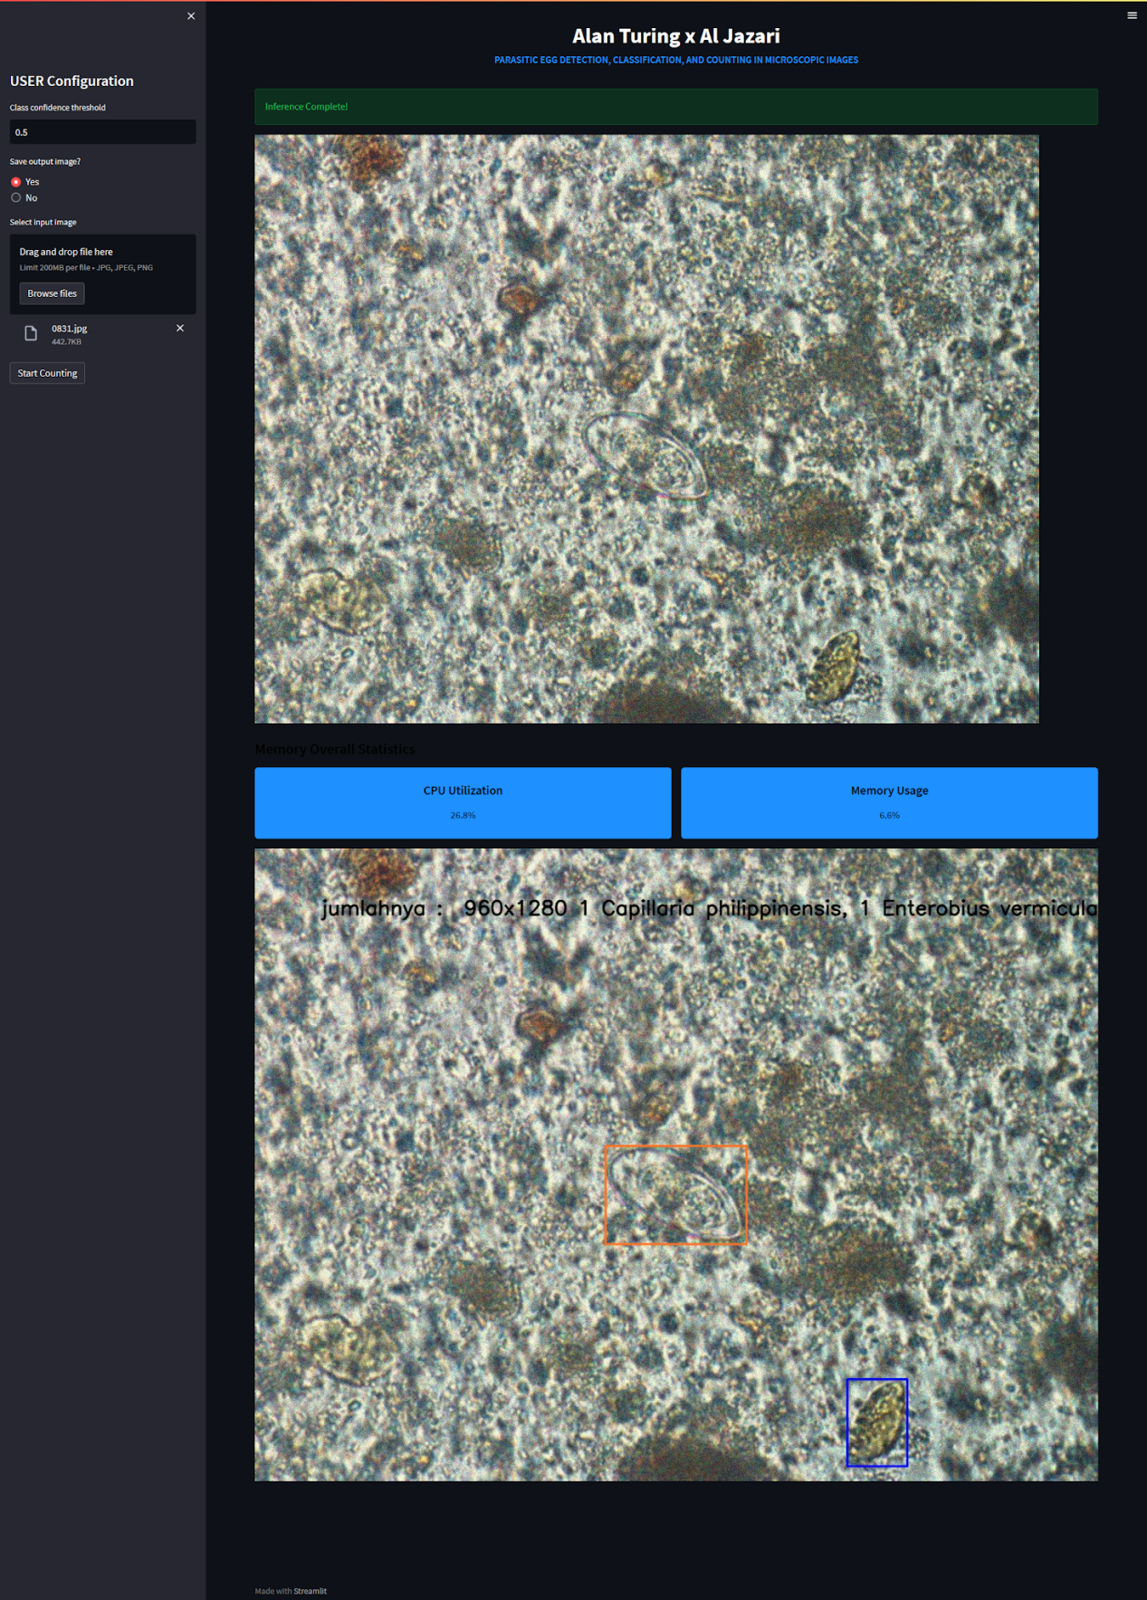
Real-world Application
We deploy our model in streamlit and gives a counting feature.

Slide 19
Future Improvement
This project can be further improves by :
Expand the dataset so that more parasite eggs and/or parasite stages can be detected.
Deploy the application to computer/device so the application can run without internet and can be applied to rural region which do not have internet access.

Slide 20

Conclusion
AI can be used in healthcare system for helping to diagnose a patient.
This project is one of the example where computer vision algorithm is used to provide
parasite eggs detection to help medical doctor gives correct diagnosis.

Slide 21



Contact Us
Don’t hesitate to contact us for further inquiries or any collaborations.
Adi Bagus Andrianto
Your Full Name
Your Full Name
adiandrianto
@adidotum
Linkedin
@Instagram
Linkedin
@Instagram
Your Full Name
Your Full Name
Linkedin
@Instagram
Linkedin
@Instagram

